Slide 1

Influence of habitat condition and competition on foraging behaviour of parrotfishes
Kirsty Nash, Nick Graham, Fraser Januchowski-Hartley & David Bellwood
ARC CoE Coral Reef Studies, James Cook University

Slide 2
Herbivores: providers of ecosystem process
Abundance & Biomass ≠ Grazing Intensity
Temporal Variation
Spatial Variation
Inter-specific Variation
Ontogenetic Variation
Notes:
But simple counts of herbivore abundance or biomass doesnt necessarily reflect control of algae.
We need to consider other factors that influence grazing
Role varies among species, e.g. Browsers vs grazers
Role may shift ontogenetically, e.g. Naso annulatus is a herbivorous browser when smaller than about 20cm in length, but then shifts to being planktivorous
Foraging varies over time, e.g. With season
Foraging varies over space, e.g. Among zones or cross-shelf

Slide 3
Herbivores: providers of ecosystem process
Abundance & Biomass ≠ Grazing Intensity
Temporal Variation
Spatial Variation
Inter-specific Variation
Ontogenetic Variation
Notes:
I am particularly interested in the spatial variation.

Slide 4
Spatial variation in herbivory
To date primarily focused on changes in bite rate, bite area...
Little work looking at area covered whilst foraging
Vs.
Vs.
Notes:
Quantifies how foraging differs among locations but importantly it gives us an indication of how foraging may change in response to future impacts to the reef environment

Slide 5
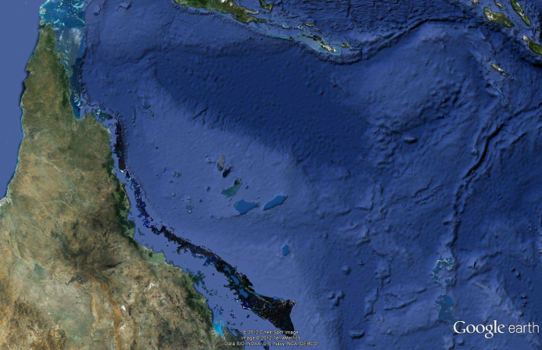
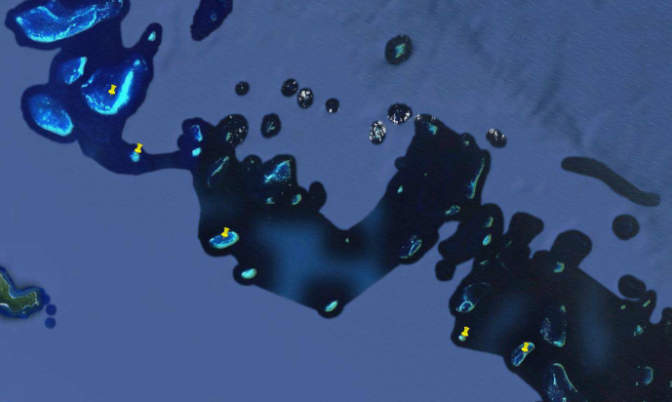
Aims
Using short-term assessments of foraging range
Quantify space use by foraging parrotfish
Compare use of space by feeding fish among sites with varying reef condition
Trunk Reef
Rib Reef
John Brewer Reef
Wheeler Reef
Davies Reef

Slide 6
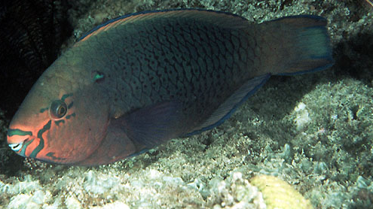
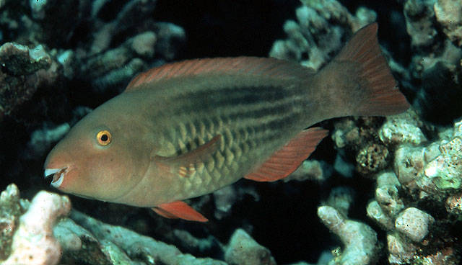
Methods
Study Species
  Initial phase Scarus niger and Scarus frenatus
In-water metrics – targets foraging behaviour
Complexity, benthic cover
Predator and competitor abundance
Photos: Randall, 1997 FishBase

Slide 7
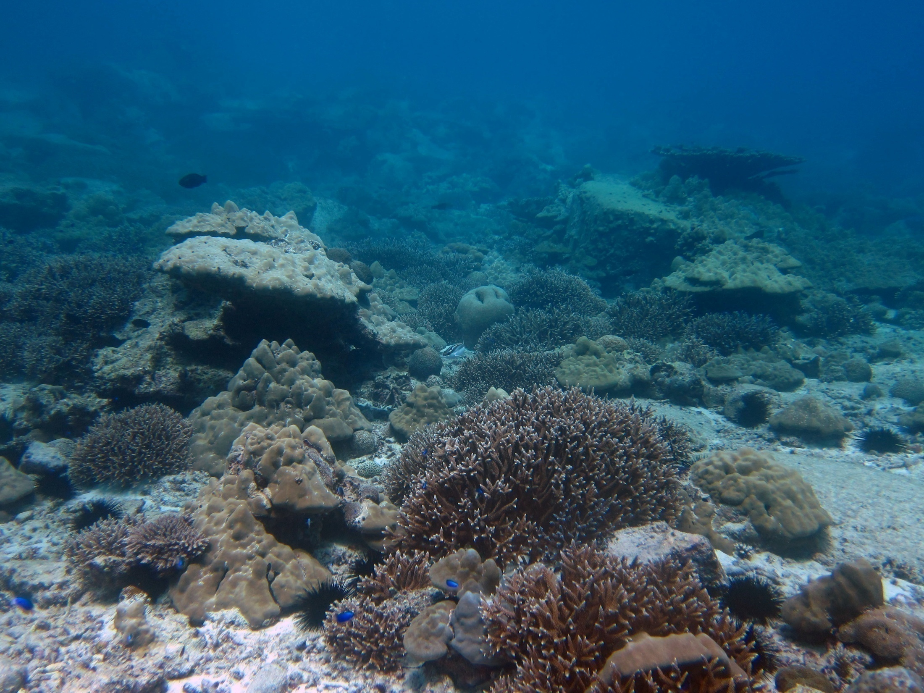
2
3
5
4
1

Slide 8
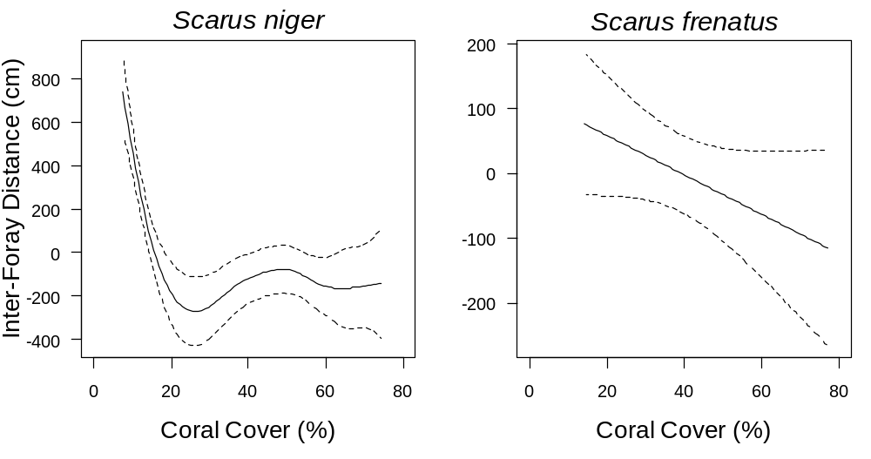
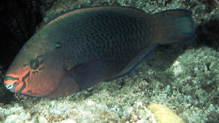

Results: Influence of Coral Cover
Nash et al, in press, MEPS
900
700
500
300
100
1400
1200
1000
800
600
400
200

Slide 9
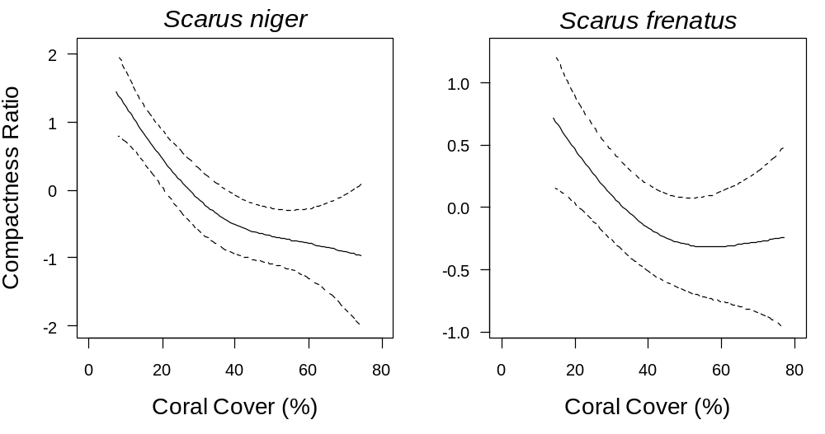
Results: Influence of Coral Cover
Nash et al, in press, MEPS
7
5
3
1
4
3
2
1
0

Slide 10
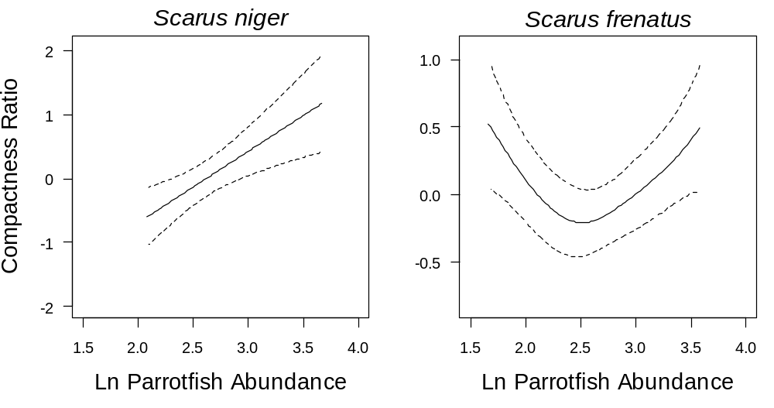
Results: Influence of Competition
Nash et al, in press, MEPS
7
5
3
1
4
3
2
1

Slide 11
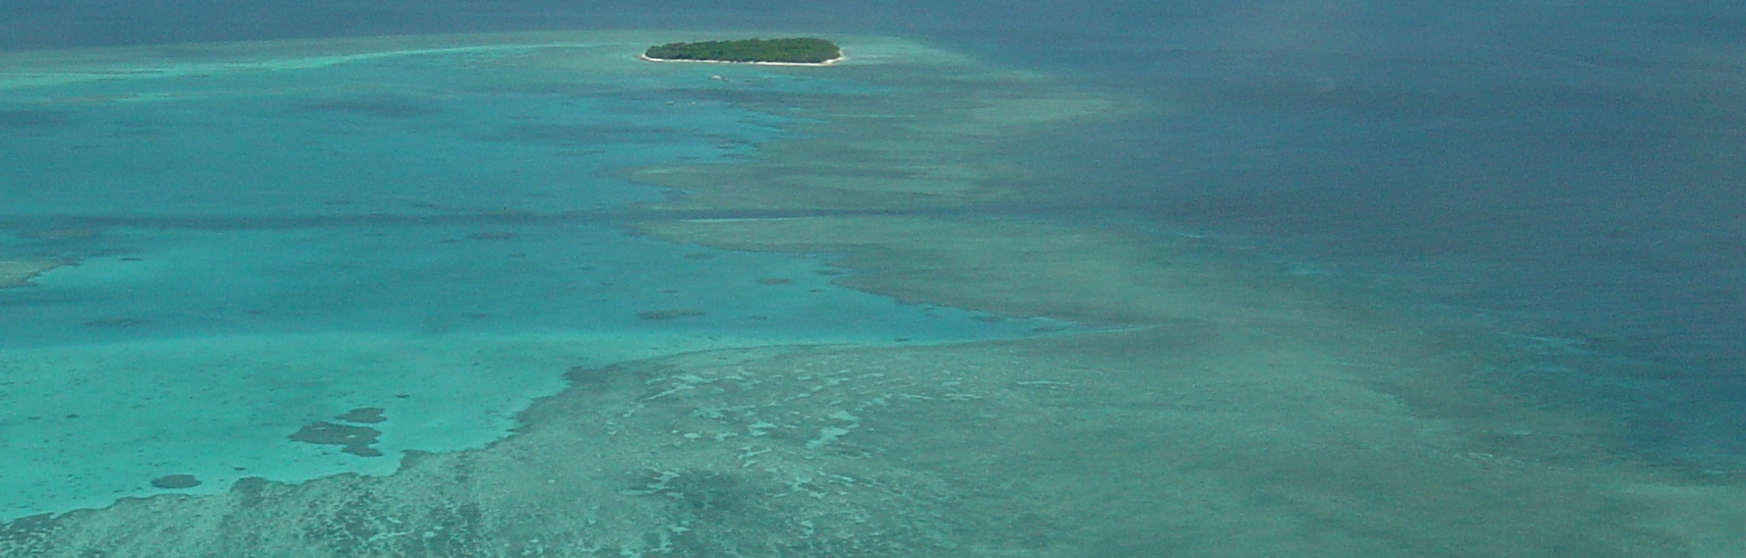
Outcomes
Coral cover & complexity at colony scale are key drivers
Competition effects weak
Need multiple metrics to assess foraging behaviour

Slide 12
Implications
Cannot make assumptions of uniform foraging across space
Herbivory likely to change as habitat condition changes
How do these small scale behavioural changes scale up to broadscale patterns of herbivory....

Slide 13
Implications
Neutral
Positive Feedback › Further degradation
Negative Feedback › Compensatory Mechanisms
?
?

Slide 14
Implications
Degradation
Diluted grazing intensity
Compensation
Increased grazing intensity
Macroalgal refuges
Contiguous cover of reef surface

Slide 15

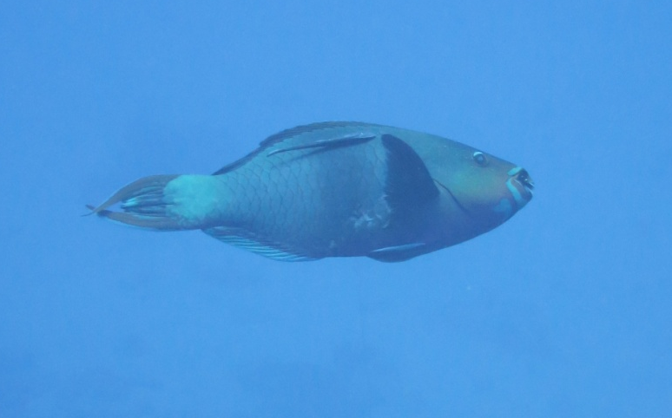
Thank you
^{Credits}
Graham Lab
Bellwood Lab
Fieldwork funded by
Queensland Smart Futures Fund and Australian Research Council
For more information:
Nash KL, Graham NAJ, Januchowski-Hartley FA, Bellwood DR. 2012. Influence of habitat condition and competition on foraging behaviour of parrotfishes. MEPS 457: 113-124.

